Slide 1
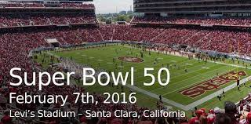
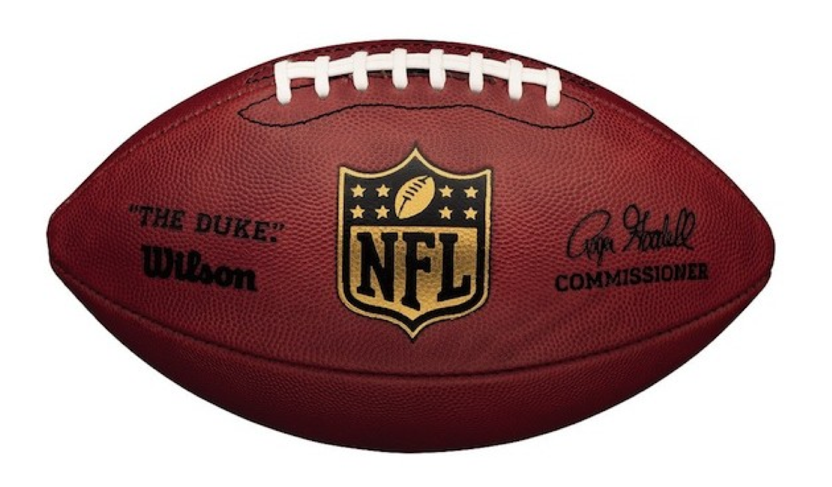
NFL – National Football League

Slide 2
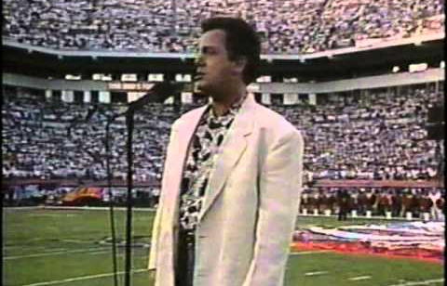
Singers perform the U.S. National Anthem at the championship games. (“Star Spangled Banner”)
January 29th, 1989 Super Bowl XXIII

Slide 3
What do Americans consume during the Super Bowl?

Slide 4
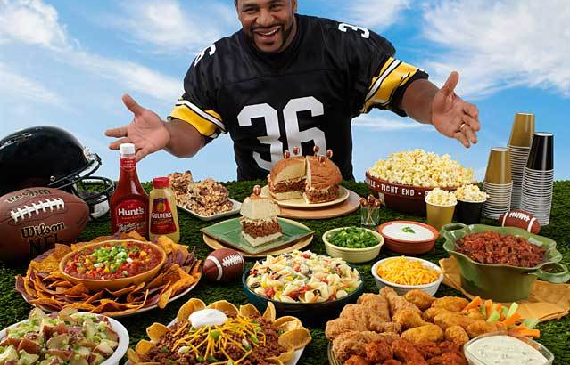

Slide 5
Now, it’s time for a short paragraph dictation.

Slide 6
On January 29th, 1989, Billy Joel sang the U.S. National Anthem at the Super Bowl XXll. The Super Bowl is the NFL annual championship game. It is the most-watched American television broadcast of the year. Twenty eight million pounds of chips, 1 billion chicken wings, and 8 million pounds of guacamole are consumed during the game.

