Slide 1
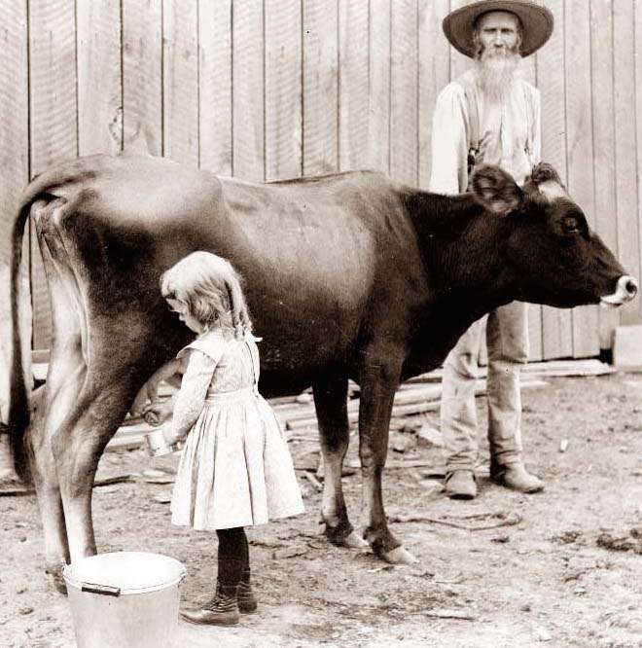
U.S. History On the Farm: Milking the Family Cow

Slide 2
Milk was first delivered in jugs in New York.

Slide 3
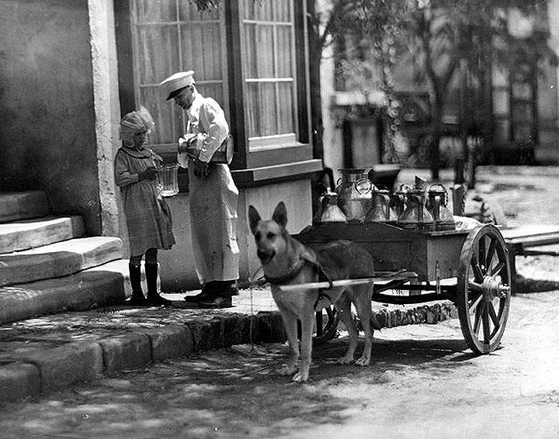
Milk delivery by dog cart, around 1910 in San Fernando Valley, California. The milkman is pouring milk into a glass pitcher.

Slide 4
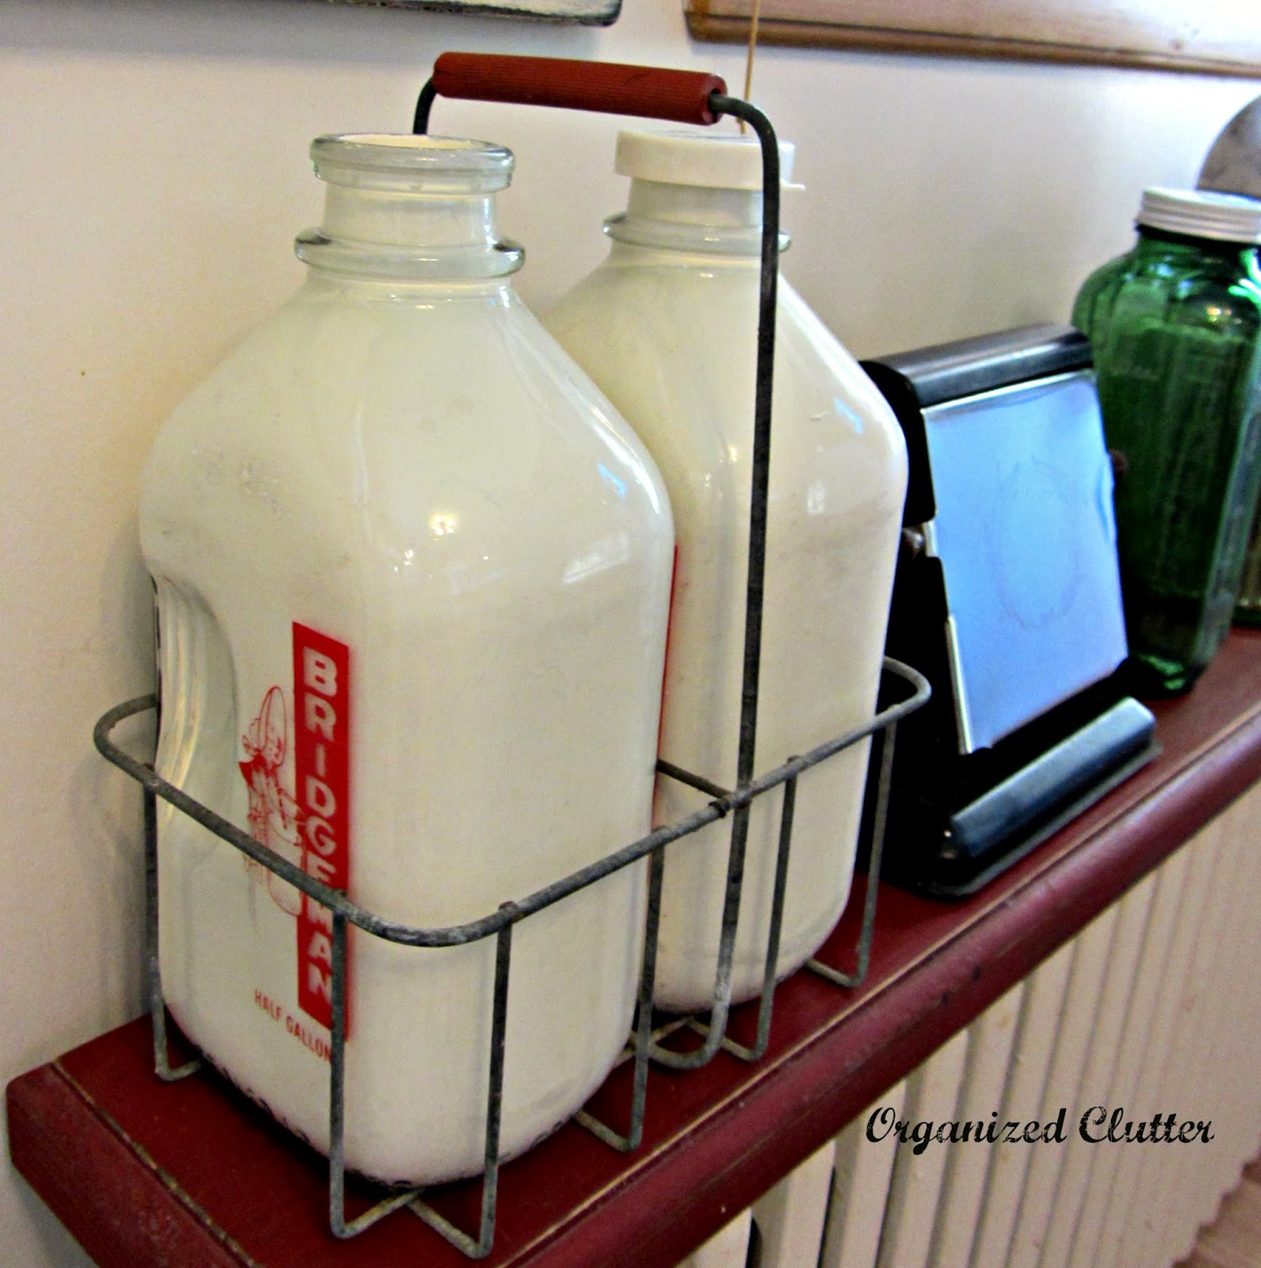
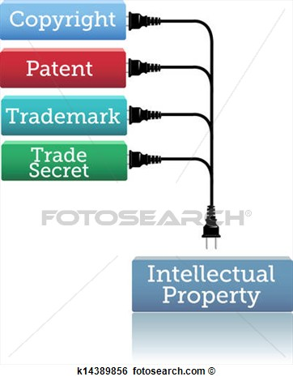
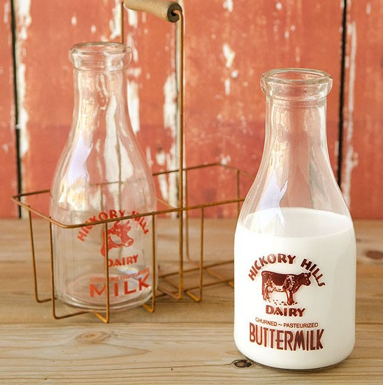
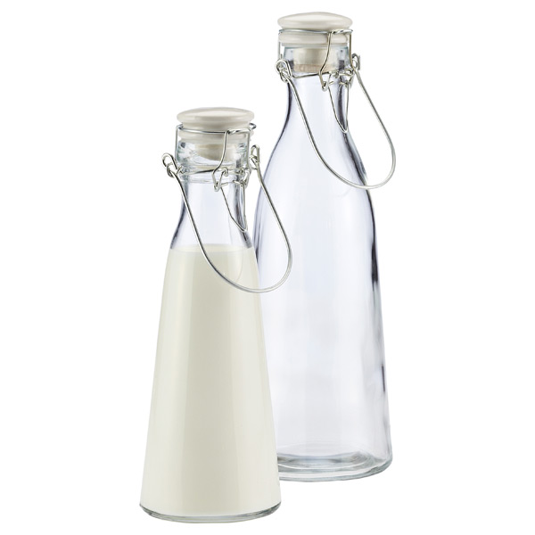
Glass bottles invented and patented!

Slide 5
Hi folks, I'm Alexander Campbell and I have been the milkman for forty-two years. I was the first to deliver milk in glass bottles! Here, I'm 74!

Slide 6
1950’s milk truck

Slide 7
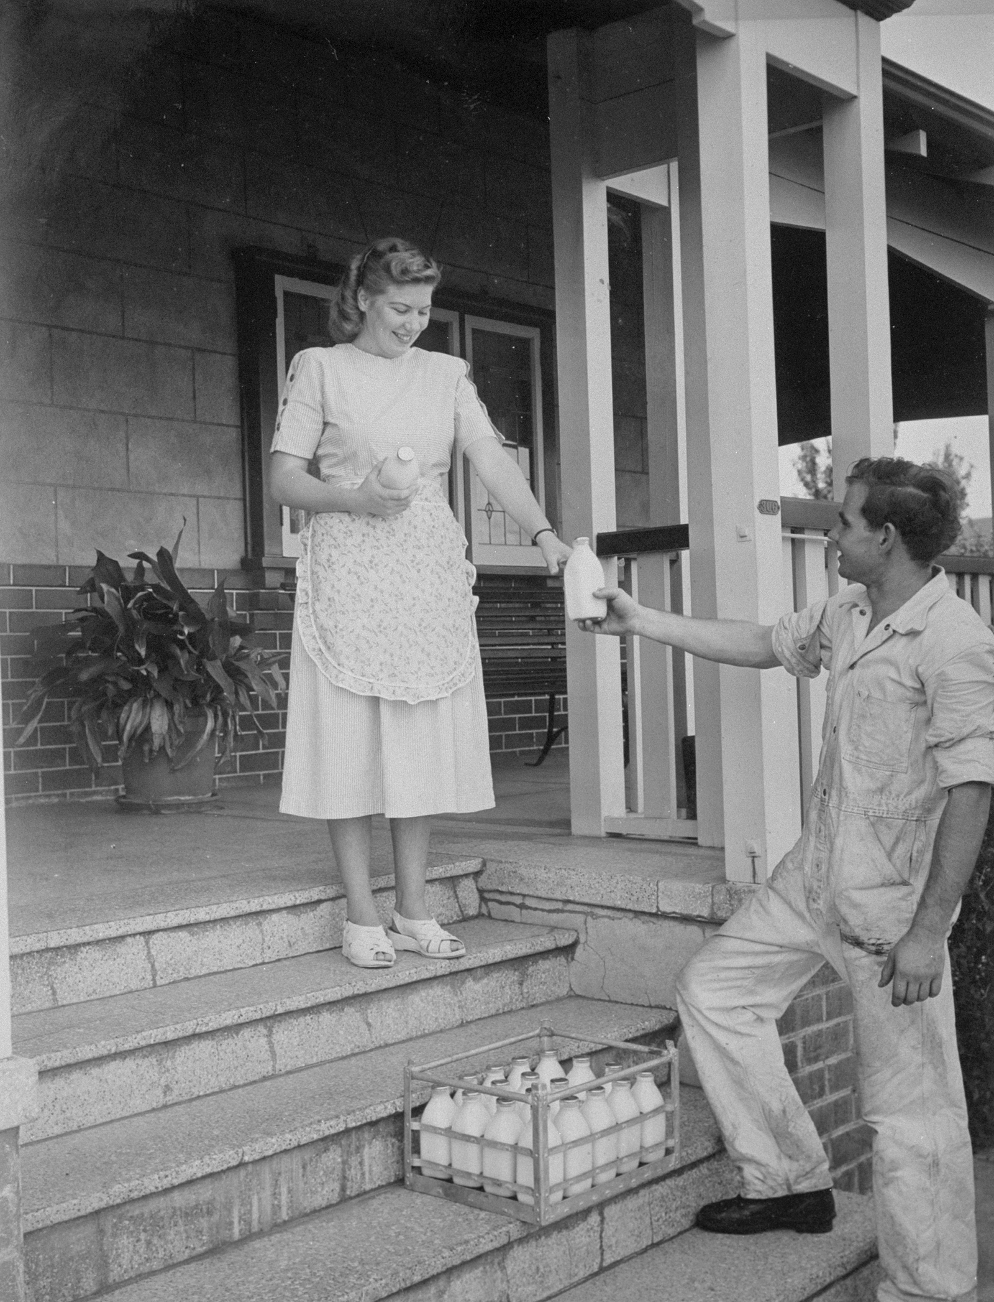
Milk Home Delivery Service

Slide 8
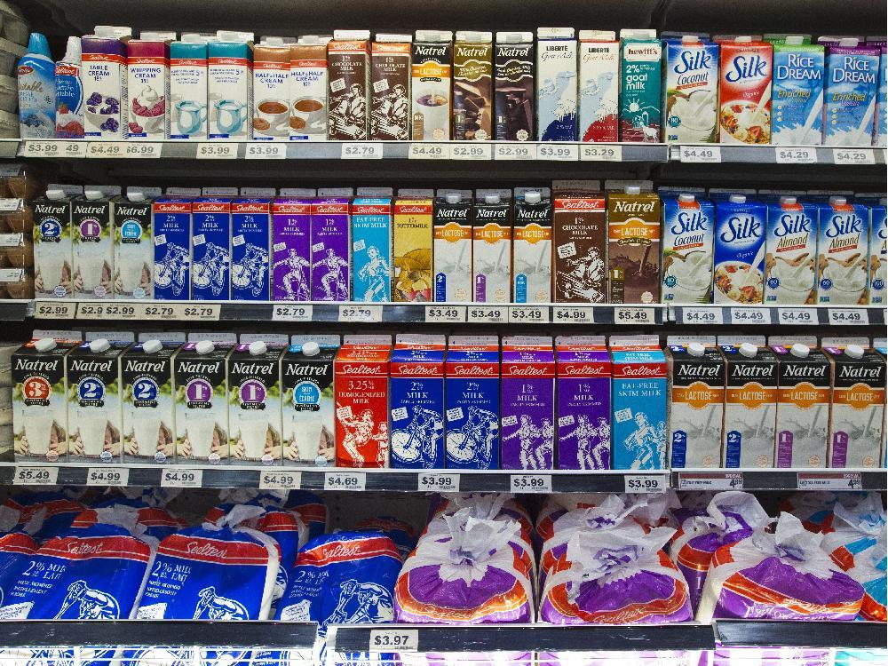
Got Milk?

Slide 9
Now, it’s time for a short paragraph dictation.

Slide 10
Dictation
On January 11th, 1878 in New York, milk was delivered in glass bottles for the first time by Alexander Campbell. Until then, milk was sold in jars. The first paper bottle was patented in 1915. Today, we buy most milk in square-shaped cartons with a sealed top.

Slide 11
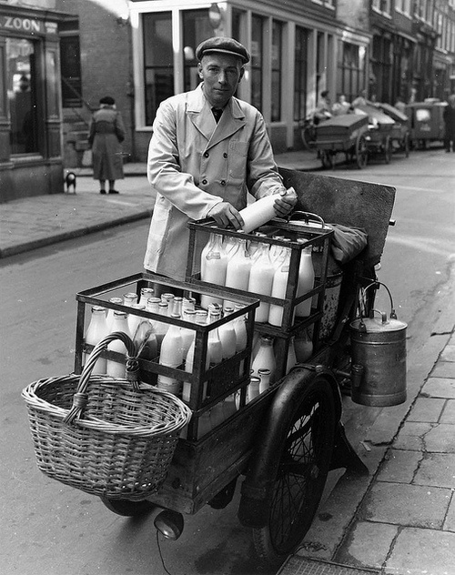
Your country
How is milk packaged? Glass, carton, stainless steel, plastic…?
When was milk in glass bottles invented?
Is there home delivery service?

