Slide 1
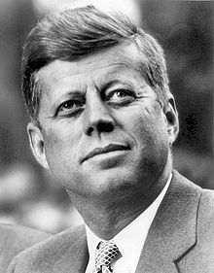
JFK
What do you already know?

Slide 2
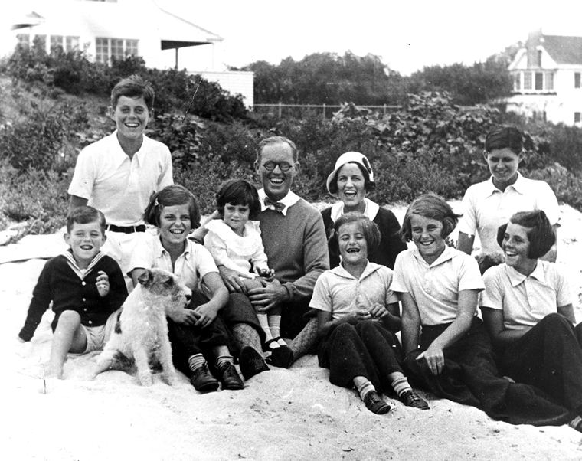
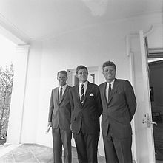
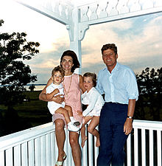

Slide 3
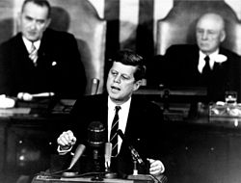
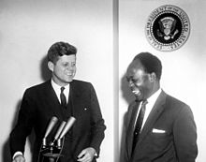
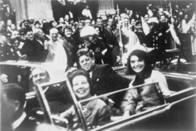
https://en.wikipedia.org/wiki/John_F._Kennedy

Slide 4
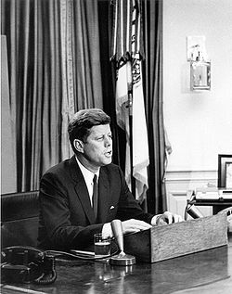
President Kennedy’s First Presidential Speech January 25th, 1961
https://www.youtube.com/watch?v=BF2YCJXFyJU

Slide 5
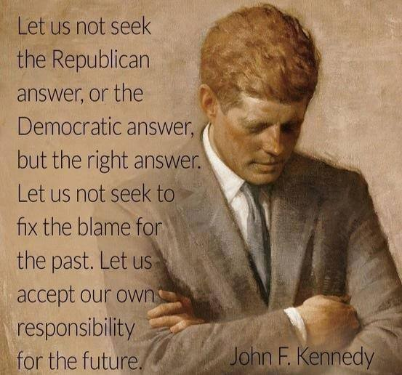

Slide 6
Dictation
On January 25th, 1961, John F. Kennedy presented the first live presidential news conference from Washington, D.C. The event was carried on radio and television. Kennedy served as the 35th President of the United States from January 1961 until his assassination in November 1963.

