Slide 1
Dress for Success: Men
Can you match the pictures with the descriptions?
Adapted from http://jobsearch.about.com/od/interview-attire/ss/interview-outfits-for-men.htm

Slide 2
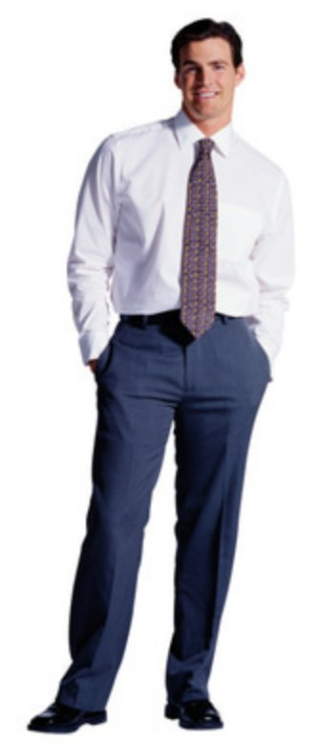
#1

Slide 3
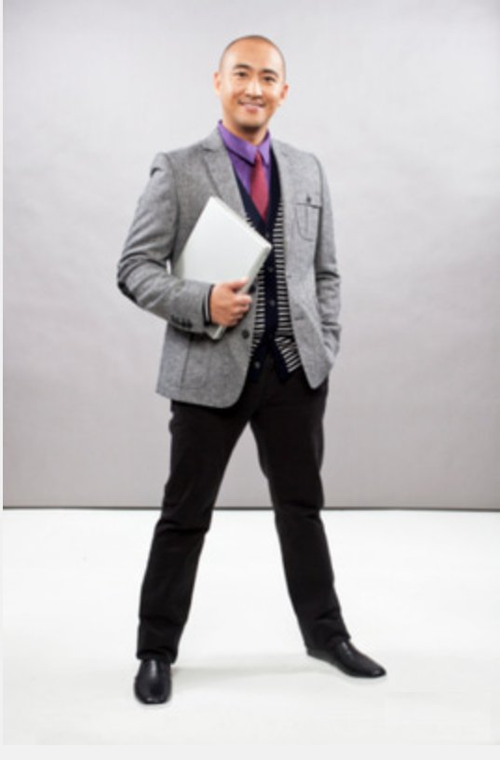
#2

Slide 4
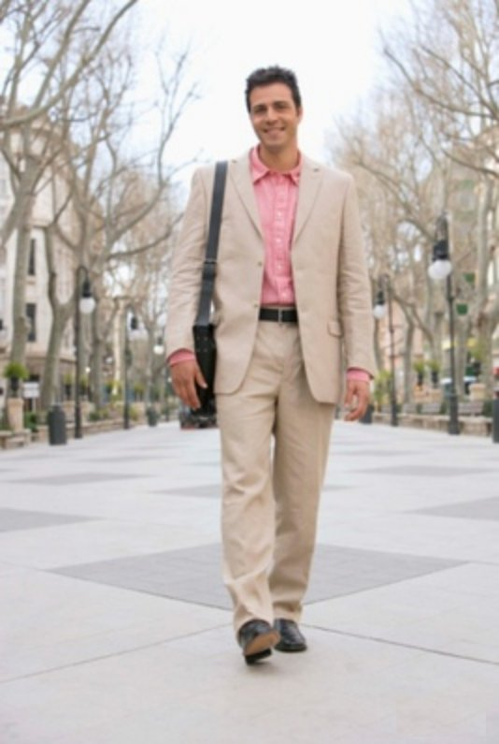
#3

Slide 5
Picture # _____
A well-fitting grey blazer or sports coat works in a business formal environment, as well as in a business casual environment. You can dress it up with a colorful button-down shirt and a tie, and it will look modern and stylish but still work-place appropriate. This look is professional, but not uptight.

Slide 6
Picture # _____
If you are not sure about the dress code at the company where you are interviewing, find the middle ground. A khaki blazer and coordinating pants are a great option. A khaki blazer is less harsh than a black or grey suit coat, and you can wear it with or without a tie.

Slide 7
Picture # _____
A pristine white button-down shirt, grey slacks and a coordinating tie is a staple job outfit for a job interview. It's also easy to put together. Because it is a simple look, it is important to make sure that each piece is in good condition and fits well. Make sure your shirt is wrinkle-free and clean, and that your slacks are pressed and pleated.

