Slide 1
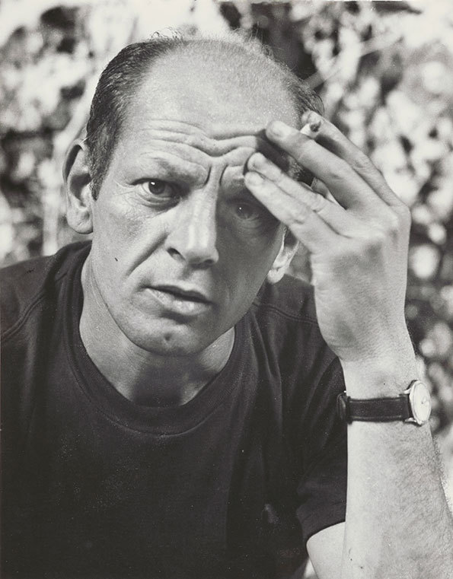
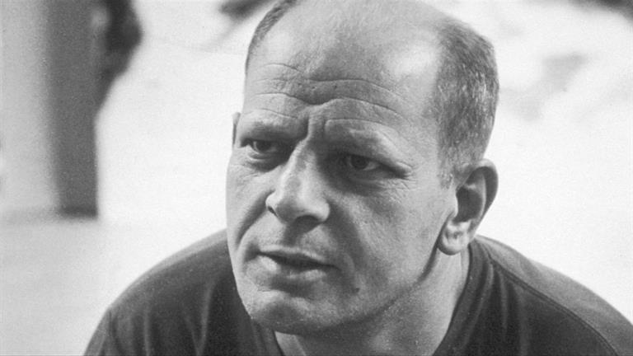
On January 28th 1912, this famous person was born in Wyoming.
Who is he? Why is he famous?

Slide 2
Jackson Pollock (January 28, 1912 – August 11, 1956)
Influential American artist
Revolutionized Modern Art
Abstract Painter

Slide 3
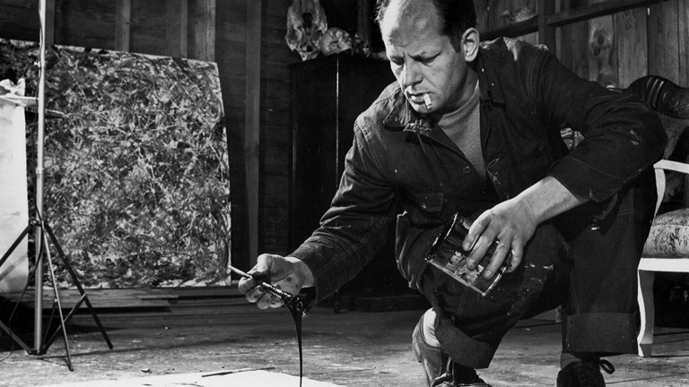
Drip Painting
Oil on canvas
He’s dripping paint onto the canvas.
He’s _________ paint.

Slide 4
“When I am in my painting, I'm not aware of what I'm doing. It is only after a sort of 'get acquainted' period that I see what I have been about. I have no fear of making changes, destroying the image, etc., because the painting has a life of its own. I try to let it come through. It is only when I lose contact with the painting that the result is a mess. Otherwise there is pure harmony, an easy give and take, and the painting comes out well.” —Jackson Pollock, My Painting, 1956
https://www.youtube.com/watch?v=EL_CwXXIoRw

Slide 5
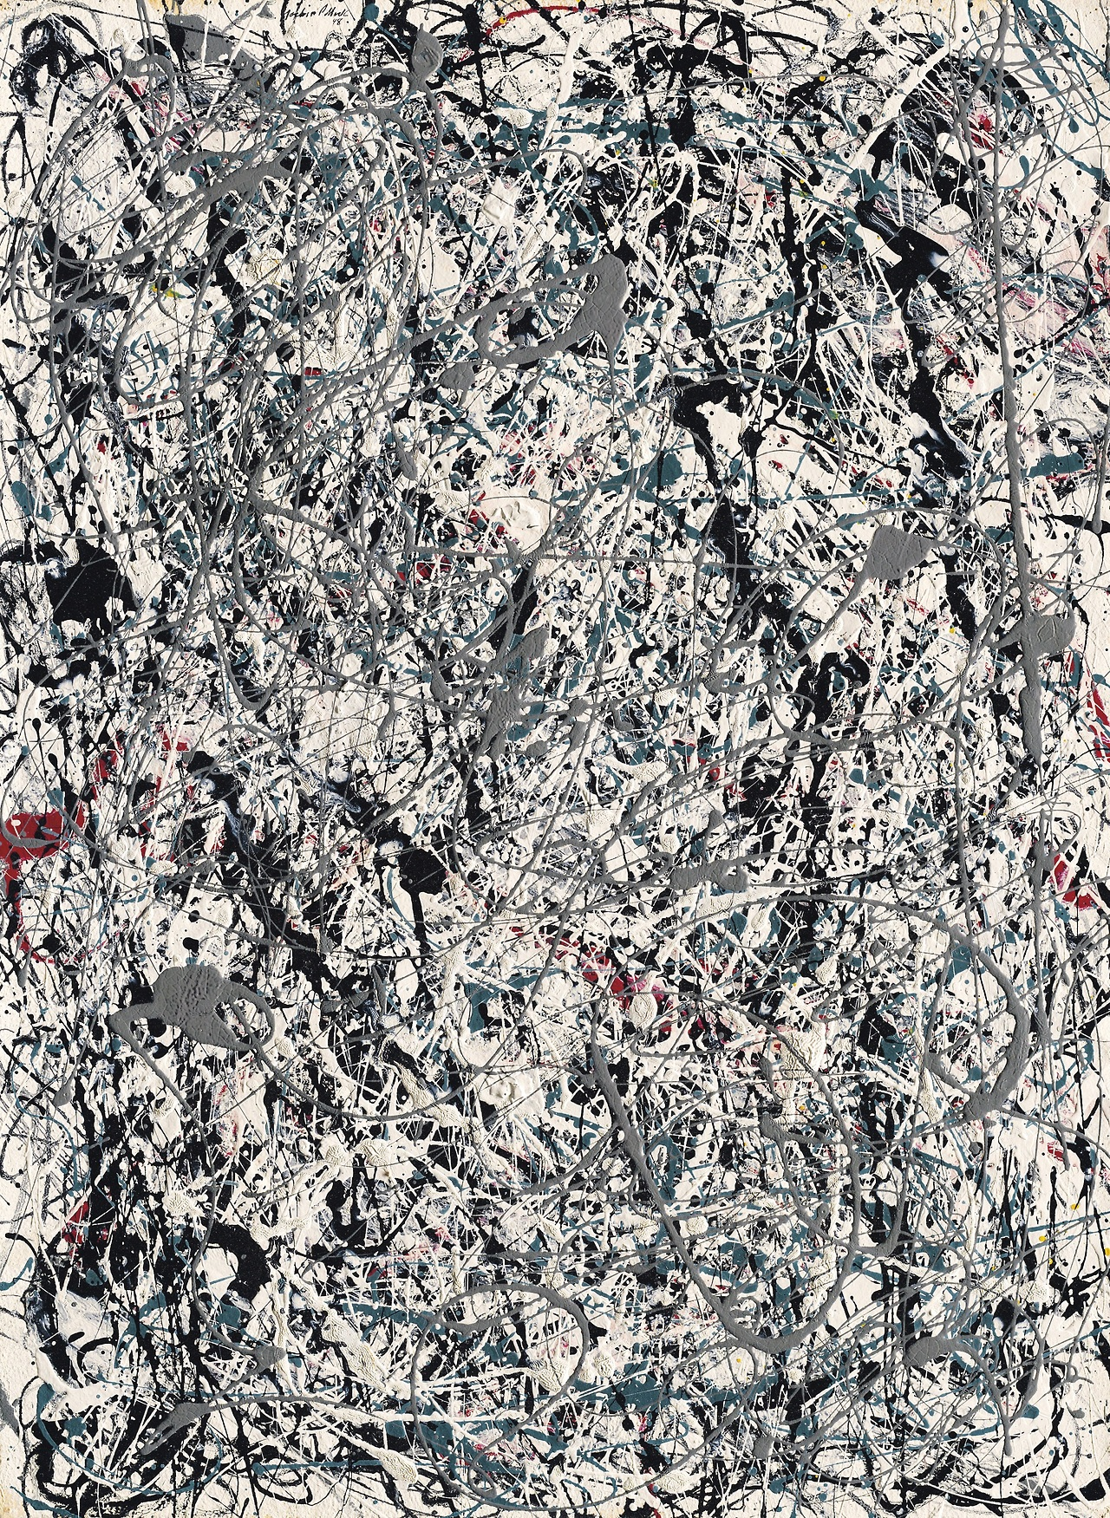
Notes:
Painting Number 19, 1948

Slide 6
Painting Number 19 Christie’s Auction NYC 2013
https://www.youtube.com/watch?v=1HHRem-lvg8
Notes:
the most expensive Jackson Pollock painting ever sold. Sold for $58M
Christie's called it the fruit of "a legendary three-year burst of creativity between 1947 and 1950 that completely revolutionized American painting and reshaped the history of twentieth century art."

Slide 7
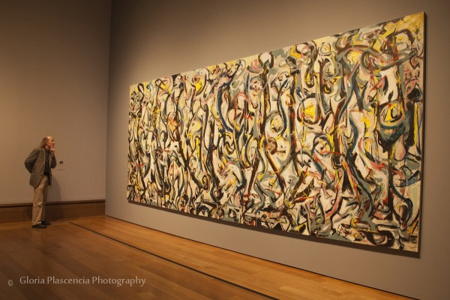
At the Getty Museum

Slide 8
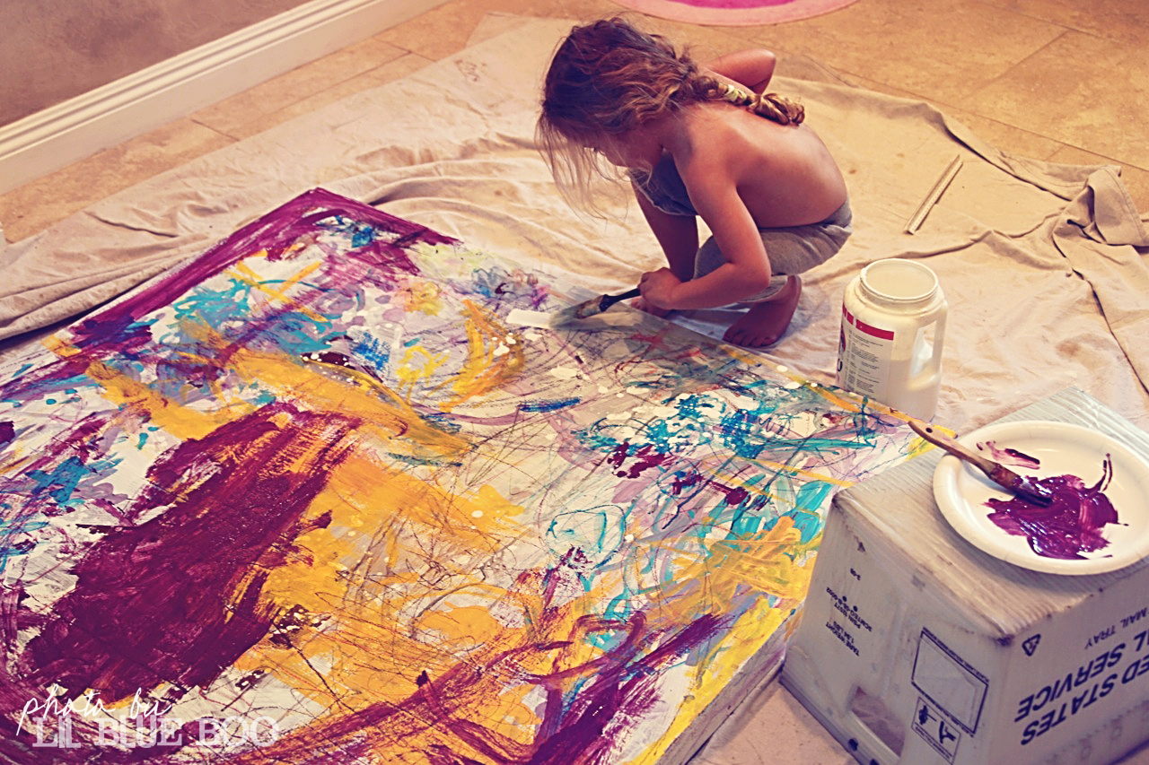
Children Paint Like Pollock!

Slide 9
Now, it’s time for a short paragraph dictation.

Slide 10
January 28th Dictation
On January 28th, 1912, Jackson Pollock, an abstract painter, was born. Jackson revolutionized modern art with his drip paintings, which involved pouring paint directly onto canvases. He died after driving drunk and crashing into a tree at age 44. His painting Number 19 sold in 2013 for $58 million.

