Slide 1
Dress for Success: Women
Can you match the pictures with the descriptions?
Adapted from http://jobsearch.about.com/od/interview-attire/ss/interview-outfits-for-women.htm

Slide 2
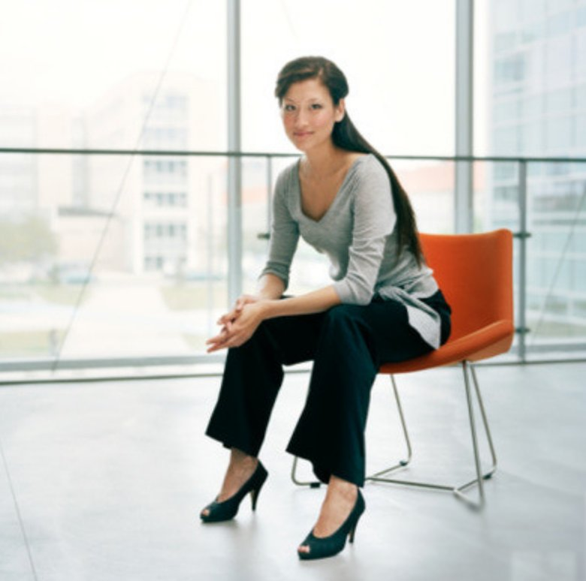
#1

Slide 3
#2

Slide 4
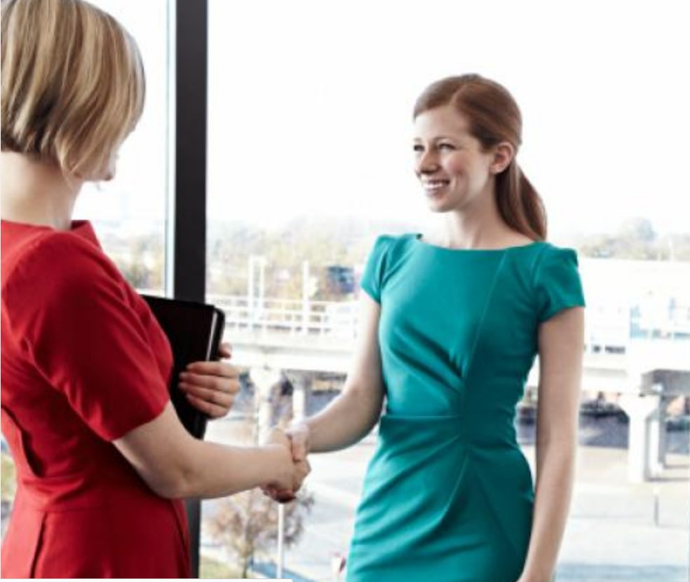
#3

Slide 5
Picture # _____
This great business casual interview outfit is comprised of three simple yet versatile pieces that are simple. A navy blue blazer is a great addition to your interview wardrobe. You can wear it on numerous occasions and it works well with different outfits. Paired with a white button shirt, it is a staple combination that you can wear with khaki pants, a knee-length khaki skirt, and even dark-wash jeans for a casual interview.

Slide 6
Picture # _____
A pair of classic black slacks is an essential part of a woman's interview wardrobe. Once you have a good pair of dress pants, it's easy to dress them up, or dress them down. You can wear them with a blazer for a formal look, or with a sweater for a casual look. Add a top with an interesting detail to soften the look. Peep-toe heels with a moderate heel height are fashionable but still tasteful. Or wear a pair of flats or loafers to dress down your look.

Slide 7
Picture # _____
Although your interview attire should be professional and conservative, you can experiment with color. A tasteful dress in an interesting color, like muted turquoise or deep red, is a good addition to your interview wardrobe. A statement dress like this speaks for itself and does not need jewelry or other accessories. When working with bright colors, make sure the rest of the dress is modest: don't experiment with necklines or hemlines and make sure that it covers you appropriately.

