Slide 1
Teaching Essay Writing Through Collaborative Group Work
Magdalena Kwiatkowski
San Diego Continuing Education
2015 CATESOL Annual Conference: Technology Through the Ages
Anaheim, California, November 14th
Notes:
I am going to talk about a method of teaching writing I have developed throughout the last five years of teaching advanced ESL at SDCE.
I teach an open enrollment class, which poses particular challenges:
Large classes
New students sometimes every day
Focus on transition to college or career has added stress to work on student writing, especially essay writing as related to college and scholarship applications and college preparedness

Slide 2
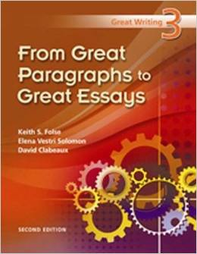
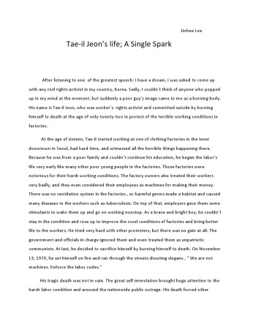
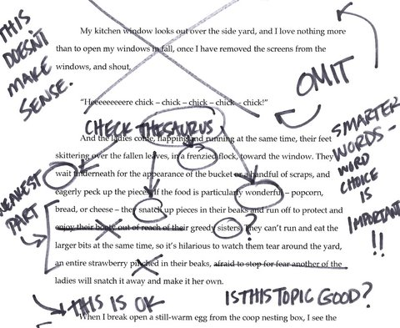
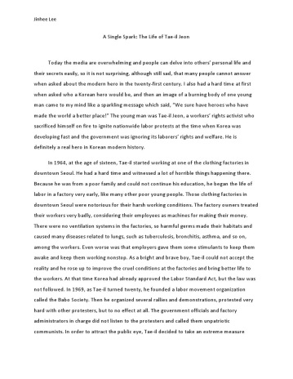
Traditional Method
Teacher provides instruction
Student writes a draft
Teacher provides feedback
Student writes the final draft
Teacher evaluates and grades
repeat
A+
Notes:
Before the student can be expected to write a 4-5 paragraph essay, he or she must have already learned a lot about essay writing. With adult ESL students, you can’t always count on their having such education, so the traditional method of teaching essay writing involves a lot of initial instruction about the structure and rules and possible pitfalls, possibly with the help of a good textbook like this one here.
It may also involve a lot of individual help with writing an outline and thinking through the content.
Then, the student writes the first draft, which the teacher reads and provides feedback. If conditions are favorable, the student gets an opportunity to write another draft, and if the situation is particularly fortuitous, this cycle may even be repeated again, until eventually the teacher evaluates the student’s work and gives the grade.
In any case, it involves a big investment of time and attention on the part of the teacher, and only one student benefits from it.

Slide 3
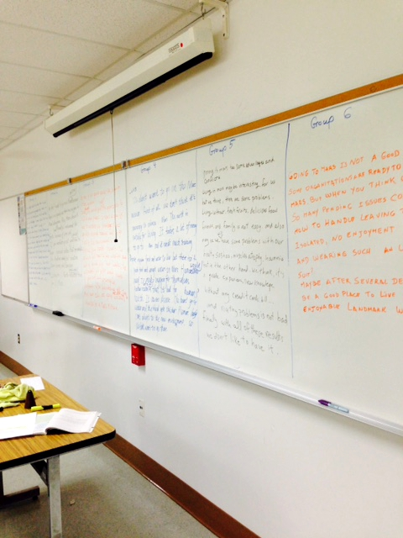
Why not a writing critique?

Slide 4
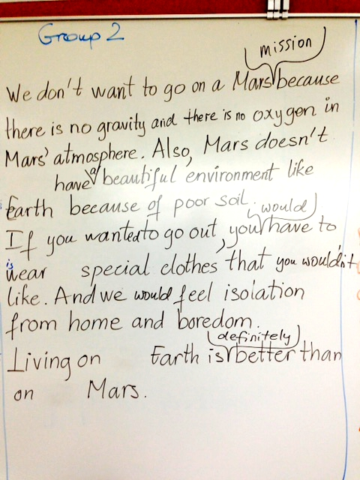
Well done Needs work
The topic sentence is there …
… although it could be articulated a little better.
There are four good arguments in support of the topic statement.
There are transition phrases between arguments …
… but we could improve them.
There is a conclusion that repeats the topic statement and wraps up the four arguments …
… which we could make a little stronger.
The language is beautiful ...
… with minor corrections.

Slide 5
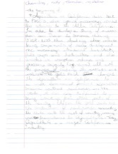
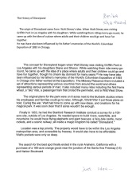
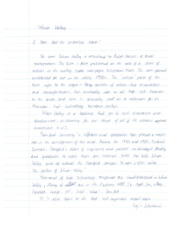
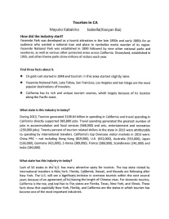
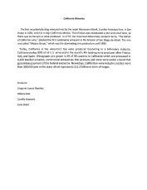
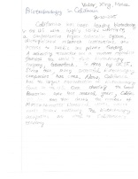
Collaborative Writing
Minimal initial instruction
The class identifies the topic and its sections(= paragraphs)
Students work in groups on their paragraphs
Teacher critiques each paragraph
Teacher combines the paragraphs together
The class discusses/writes the introduction & conclusion, & revises the essay
Repeat
several
times
Notes:
In collaborative writing, this time and attention benefit the whole class.
So here’s how it works:

Slide 6
Why write collaboratively?
The whole class benefits from the feedback, not just individual students
Feedback is given incrementally, and thus is more effective
Several writing projects can be accomplished within the semester
Plus …
… all the advantages of the Participatory Approach
Notes:
So again, the benefits of this method:
SLIDE
So, what is the Participatory Approach?

Slide 7
“Teachers and students, co-intent on reality, are both Subjects, not only in the task of unveiling that reality, and thereby coming to know it critically, but in the task of re-creating that knowledge. As they attain this knowledge of reality through common reflection and action, they discover themselves as its permanent re-creators.” Paulo Freire, Pedagogy of the Oppressed
What is the Participatory Approach?
Notes:
It is an approach to teaching where students are encouraged to take a look at the reality around them and work to develop a voice they could use to speak for themselves.
It is an approach in which the student’s point of view is acknowledged, and the student is helped to believe that their view point is just as valuable as that of the teacher or anybody else.
READ THE QUOTE
Students take a critical look at the social reality around them and work to develop a voice they could use to speak for themselves and for their community.
You may think that it doesn’t have much to do with some of our students; after all, not all come from impoverished societies, but I believe it does have a lot to with immigrants, for the one reason that the one thing that they have lost and are trying to regain is their voice, that is, language. Also, culturally, not all of them are as prepared to expressed themselves verbally as it is expected in this culture.
I have to say that I didn’t know much about Paulo Freire as I was first asking my students to do group writing, but when I finally realized that that’s what I was doing and read more about his philosophy, I found it very helpful since I could see why it was so effective, and why students took to it so enthusiastically.
In practical terms, it means:
A problem-posing approach
Related to students’ lives
Revolutionary idea was that everyone had a unique point of view on life and that no one person had a better point of view than anyone else; if everyone worked together, they could build upon their knowledge rather than just learning the point of view of one person
This text argues that the ignorance and lethargy of the poor are the direct result of the whole economic, social and political domination. The book suggests that in some countries the oppressors use the system to maintain a 'culture of silence'. Through the right kind of education, the book suggests, avoiding authoritarian teacher-pupil models and based on the actual experiences of students and on continual shared investigation, every human being, no matter how impoverished or illiterate, can develop a new awareness of self, and the right to be heard.
Refer them to the YouTube on the last slide

Slide 8
Day 1
Sources of wealth in California:
gold
tourism
agricultural crops
wine
Silicon Valley
biotechnology
Hollywood
Disneyland & amusement parks
Sandra, Fei
Hannah, Mayuko, Xiaoyan
Tamila, Vicky, Chia-ling
Gregorio, Milena, Camille
Hy, Alisher, Limin, Changjun
Melee, Victor, Xing
Murielle, Nancy
Reina,Yoshi, Ibolya, Faryal, Shahrzad
Step 1: The class decides on the topic and breaks it down into sections
Step 2: Students volunteer to collaborate on the paragraph of their choice
Step 3: Students begin to do the research
How did the industry begin?
In what shape is it now?
Find 3 interesting facts about it.
Notes:
Let me walk you, day by day, through the most recent project we have been working on to illustrate this method, and then show you some other ways in which we have done it.
The topic of the essay usually comes out of a discussion that has generated a lot of interest. If something causes a lot of discussion, it is a sure sign that it has great potential as a topic for group writing.
In this case, the interest on the different sources of wealth in California was sparked by a story by Mark Twain, The Californian’s Tale, which we read in class, about the life of gold seekers during the times of the Gold Rush. We talked about ghost towns it left behind that some of the students have visited, how they came to prosperity and then perished, and it prompted a discussion of the different sources of wealth in California. It’s a topic that is very much related to students’ lives, as they are among the thousands and millions of people who have come here in search of a piece of that prosperity for themselves and their families.
…

Slide 9
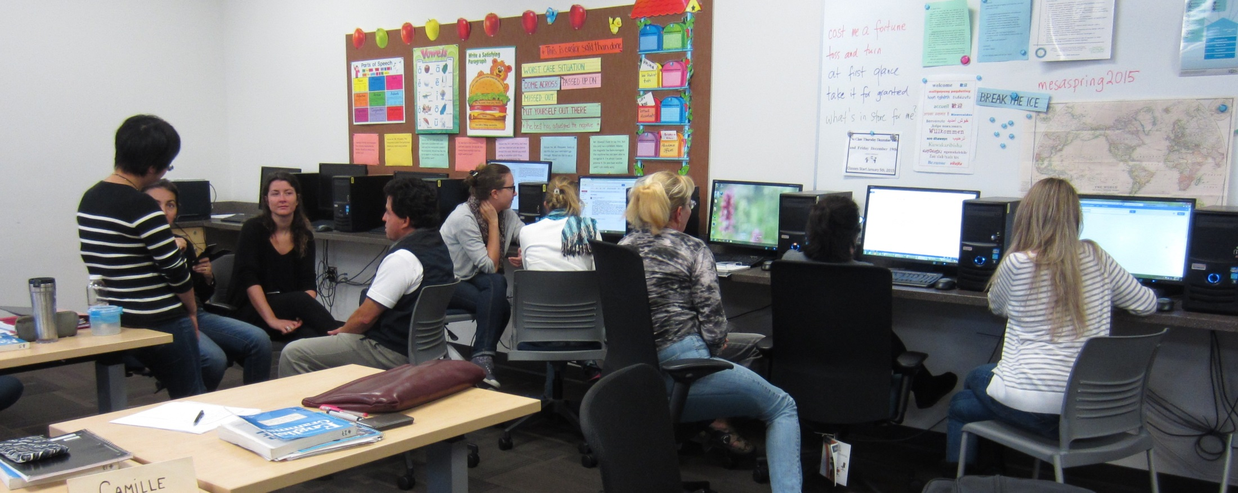

Slide 10
Day 2
Did you answer all the questions?
Did you find enough information?
Is some information redundant?
Step 4: First critique
Step 5: Students continue to work in their groups
To do next:
do more research if necessary or cut down some detail
paraphrase the text if necessary
attempt to formulate the topic sentence
type the paragraph
Notes:
On Day 2, which doesn’t have to be the next day, we take the first critical look at the work they have so far created.
The first critique focuses on the content, and not on language or structure.
Their assignment after their first critique is to …

Slide 11
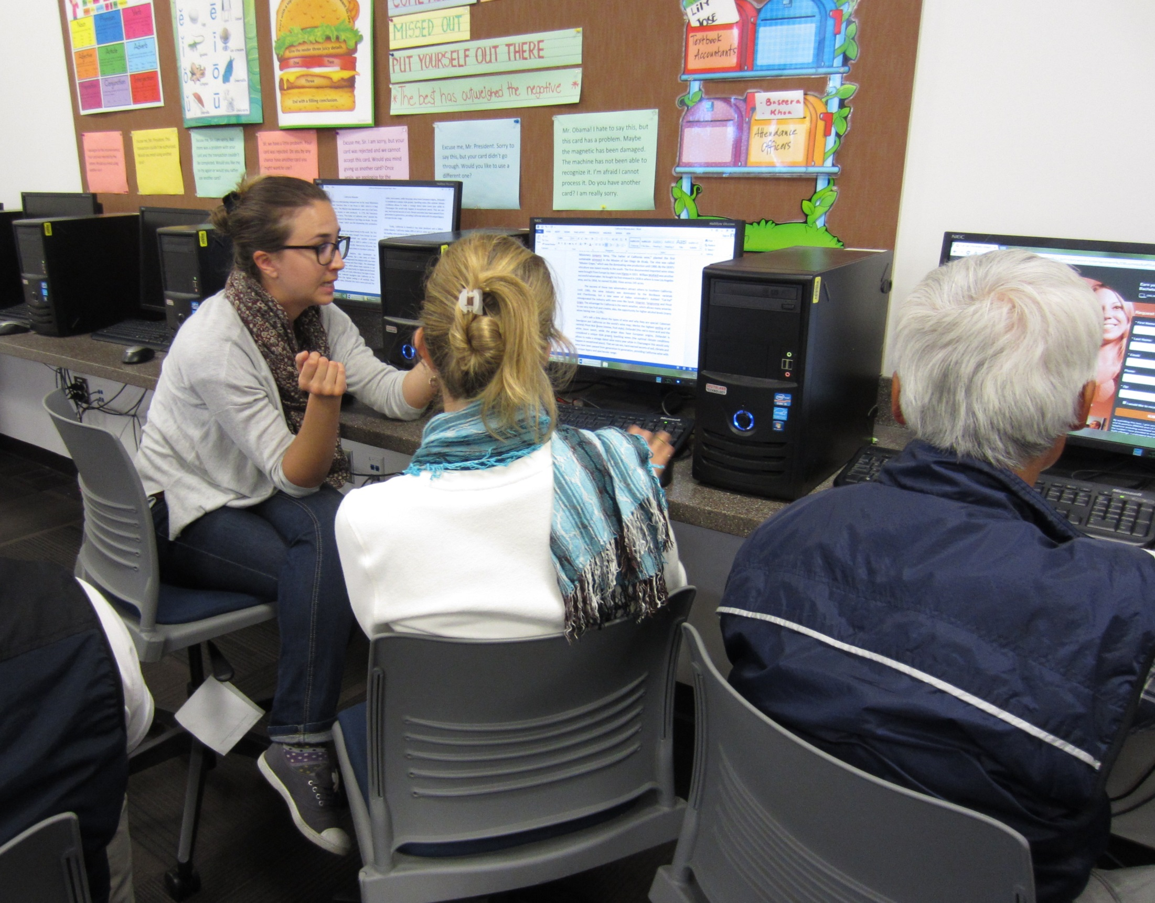

Slide 12
Day 3
Is the topic sentence appropriate?
Is the information well organized?
Are you using transition phrases?
Is the language correct?
Step 6: Second
critique
Step 7: Students continue to work in their groups
To do next:
refine the topic sentence
correct grammar, vocabulary, and spelling
provide a reference
Notes:
The second critique focuses on organization of the information and slowly turns students’ attention to language and format.
The next step is …

Slide 13
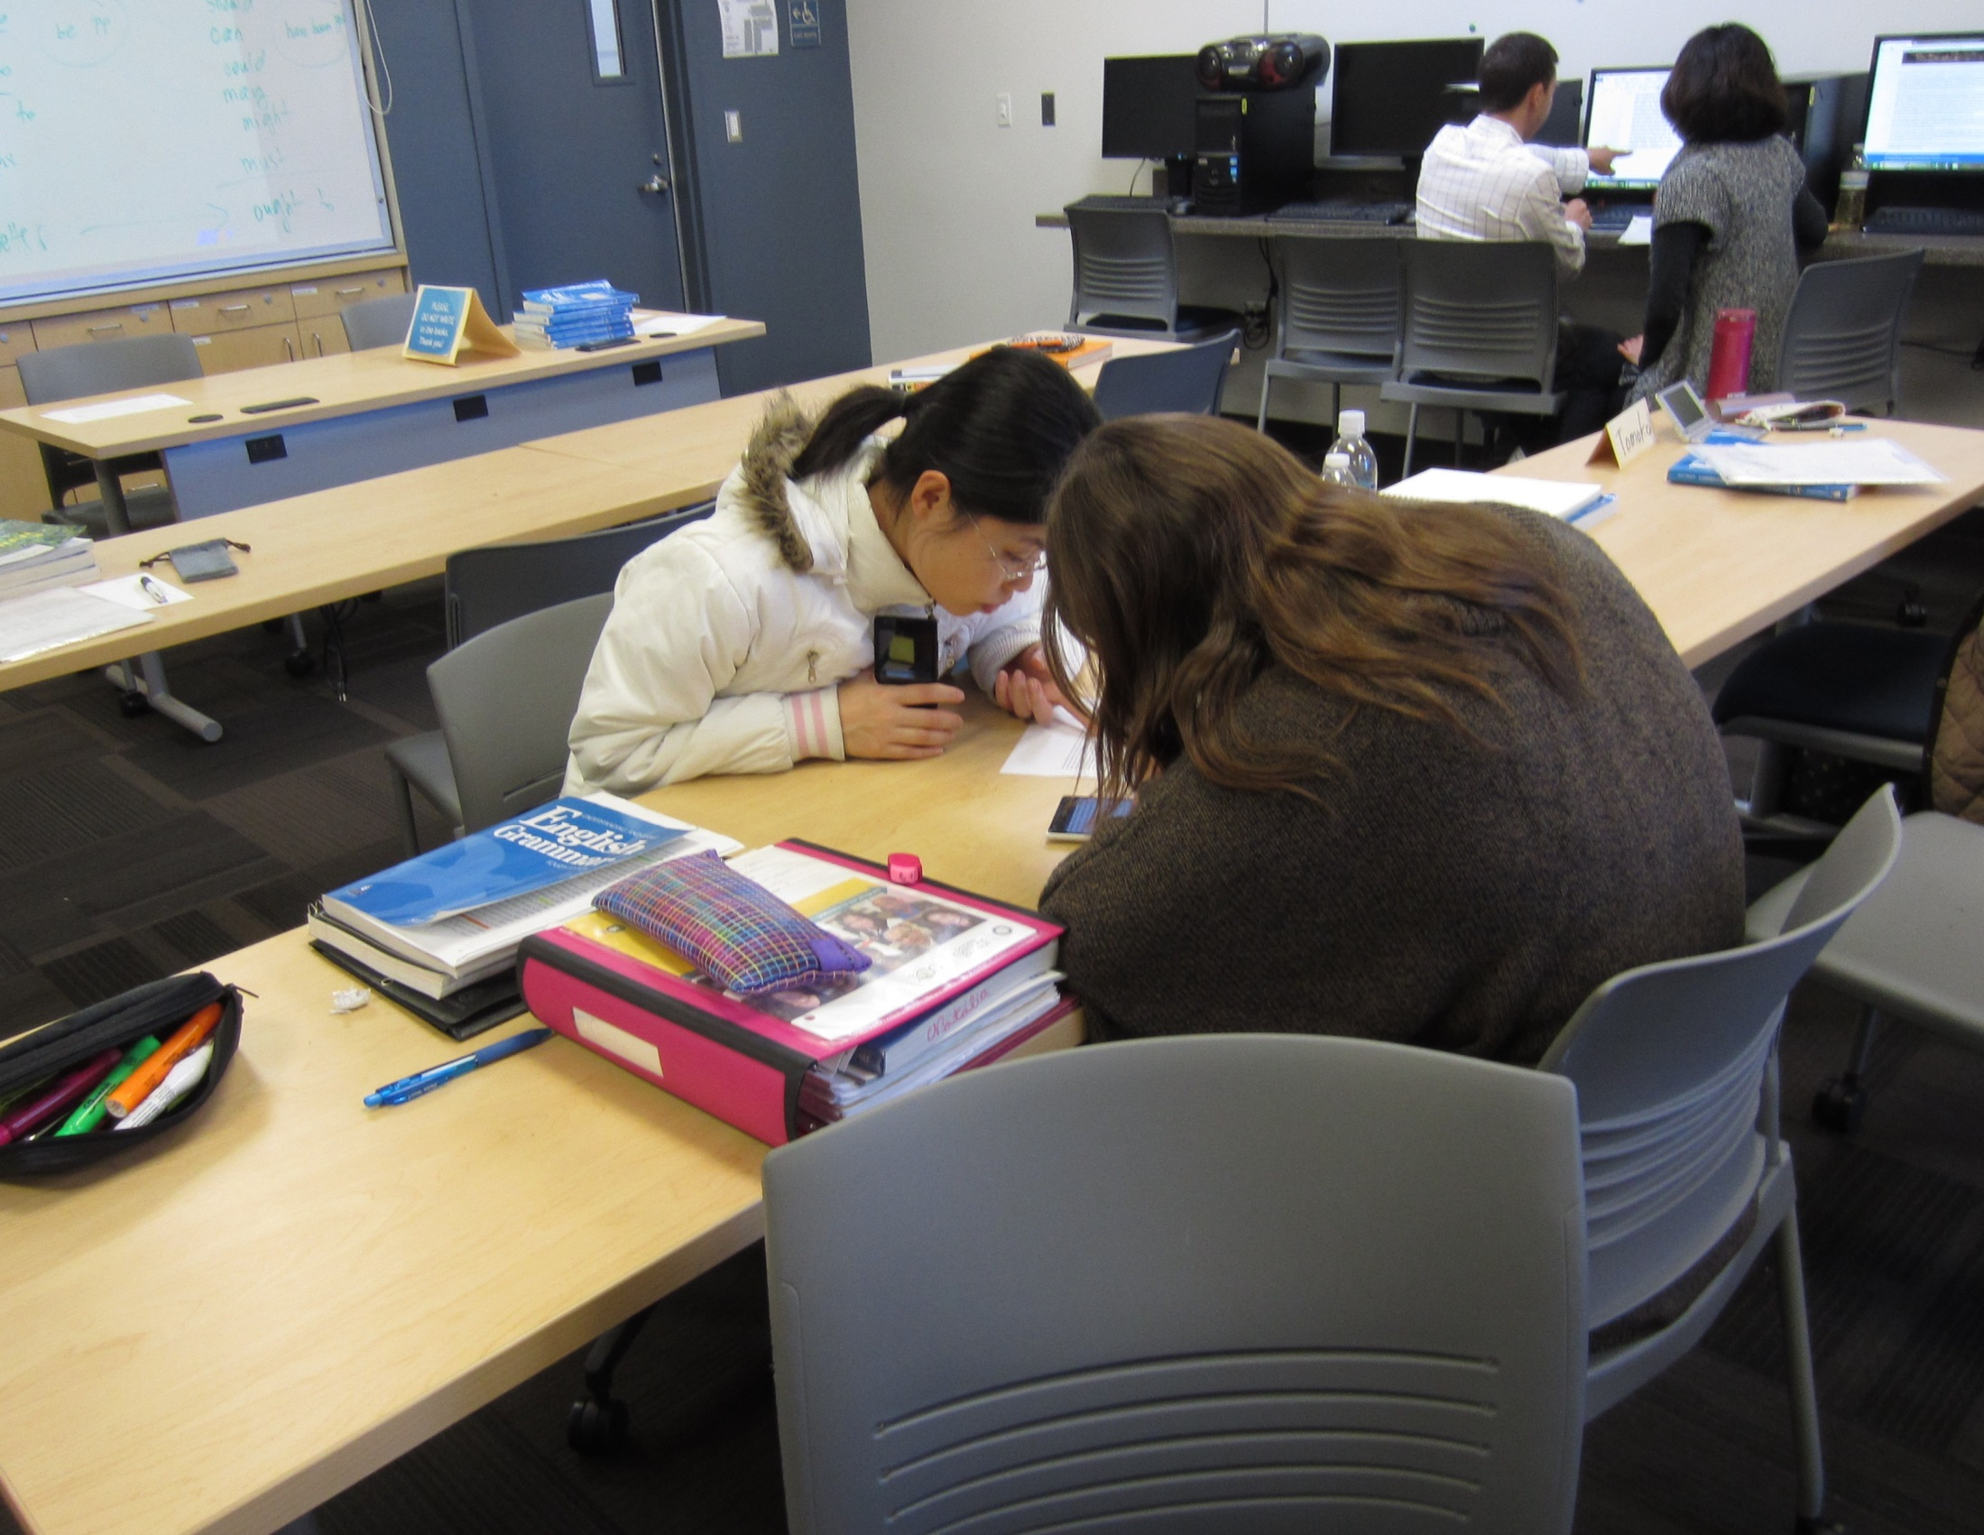

Slide 14
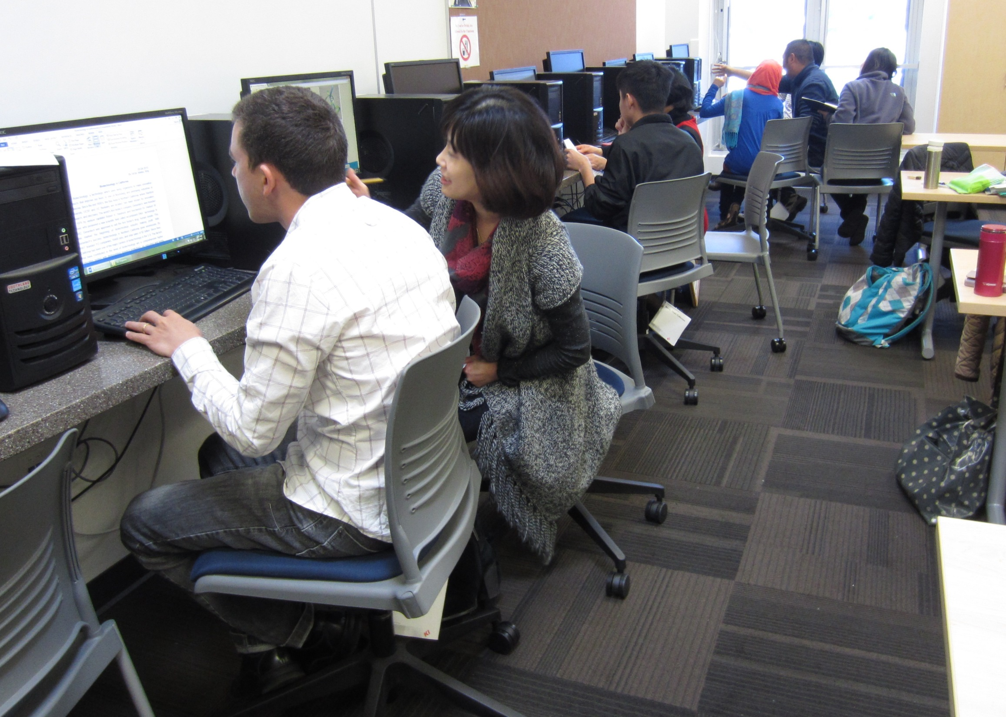

Slide 15
Day 4
In what order do we arrange the paragraphs?
Step 8: Teacher puts the paragraphs together
Step 9: Class works on the introduction
How do we begin? What hook do we use?
What is our thesis?
How much background info do we want to include?
Notes:
There usually are no more than two critiques because several paragraphs get critiqued and since students work at a different pace, across those critiques pretty much everything gets covered and there’s no need for the third round of critiques.
When students finish working on their paragraphs, we talk about the order in which they should be put together and we begin to work on the introduction.
Depending on the time, sometimes I write the introduction, but if I do, it is always based on what we said we need to include in the introduction.
This time, since some groups have finished earlier and some were still working on the second or third draft, I asked the two groups that were done to write a draft of the introduction and I am going to combine them into the introductory paragraph.
The point is that it is their voice that gets captured, and they know it.
…

Slide 16
Day 5
Does every paragraph respond to the thesis?
Does every paragraph have a topic sentence?
Are the paragraphs balanced in terms of content and length?
Do we have transition phrases?
Step 10: Final revision & conclusion
How do we wrap it all up?
Does the conclusion match the thesis?
Can we end with some uplifting message or recommendation?

Slide 17
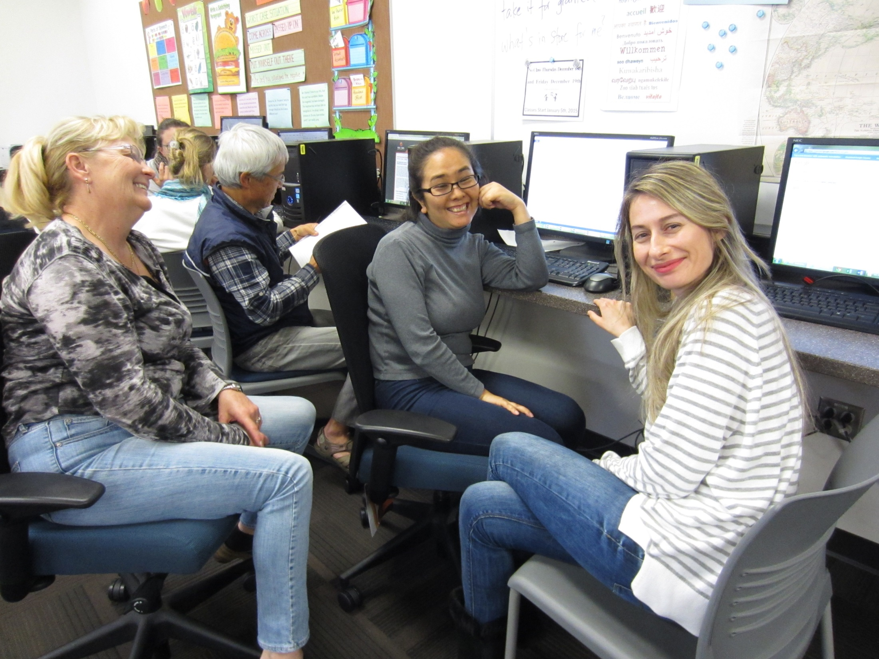

Slide 18
Publishing Venues
Magazines
Women’s Perspectives: A Journal of Writing and Art by Adult Learners
http://welearnwomen.org/index.php?option=com_content&view=article&id=90&Itemid=191
Online venues
www.stageoflife.com/Writing_Contests.aspx
Class website
www.magdaseslclass.weebly.com
Class Newsletter
$20 for 100 copies of a double-sided color flyer at MGX Copy
www.mgxcopy.com
Hall Exhibit

Slide 19
Additional Resources
Paulo Freire - An Incredible Conversation
https://www.youtube.com/watch?v=aFWjnkFypFA
Guide to Writing a Basic Essay
http://lklivingston.tripod.com/essay/index.html

